Slide 1


Slide 2
RAG on Azure SQL
Davide Mauri Principal Product Manager

Slide 3
Agenda
Azure SQL
Use Cases
RAG Pattern (with LangChain)
Full end-to-end Demo

Slide 4

Azure SQL
Modern Relational Database
True Multi-model
JSON, Graph, XML, Geospatial, Columnstore
Scalable up to 100TB, 80v-Cores, 30 replicas
Support for Vector in Early Adopter Preview
https://aka.ms/azuresql-vector-eap-announcement
Enterprise-grade security & audit features
Integration with common Azure Services
Azure Functions, Static Web Apps
Integration with most loved libraries
.NET EF Core, .NET Aspire, LangChain, Semantic Kernel, etc.

Slide 5
Azure SQL
Hybrid search: vector (semantic) search + full-text search + filters
E.g.: “Find all the documents from Acme customer written by John Doe that are related to the new security policies“
Chatbot memories
Retrieval Augmented Generation

Slide 6
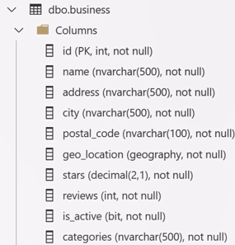
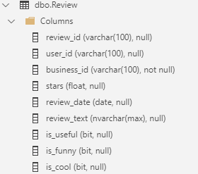
Why vectors in a modern relational database?
“Focaccia” bread
In “London”
Equality Search
Geo-Spatial
Within 5 KM Radius
“Italian” place
Regex
Good reviews (>4)
Inequality Search
Similarity Search
Enough reviews
Inequality Search
Generative AI
Other predicates + Similarity Search => Hybrid Search

Slide 7
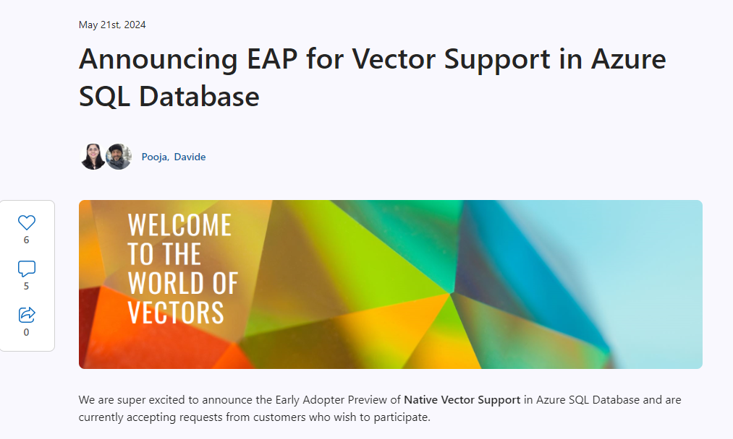
Azure SQL
Vector Support is now in Early Adopter Preview
Just read the blog post and fill out the form:
https://aka.ms/azuresql-vector-eap-announcement

Slide 8
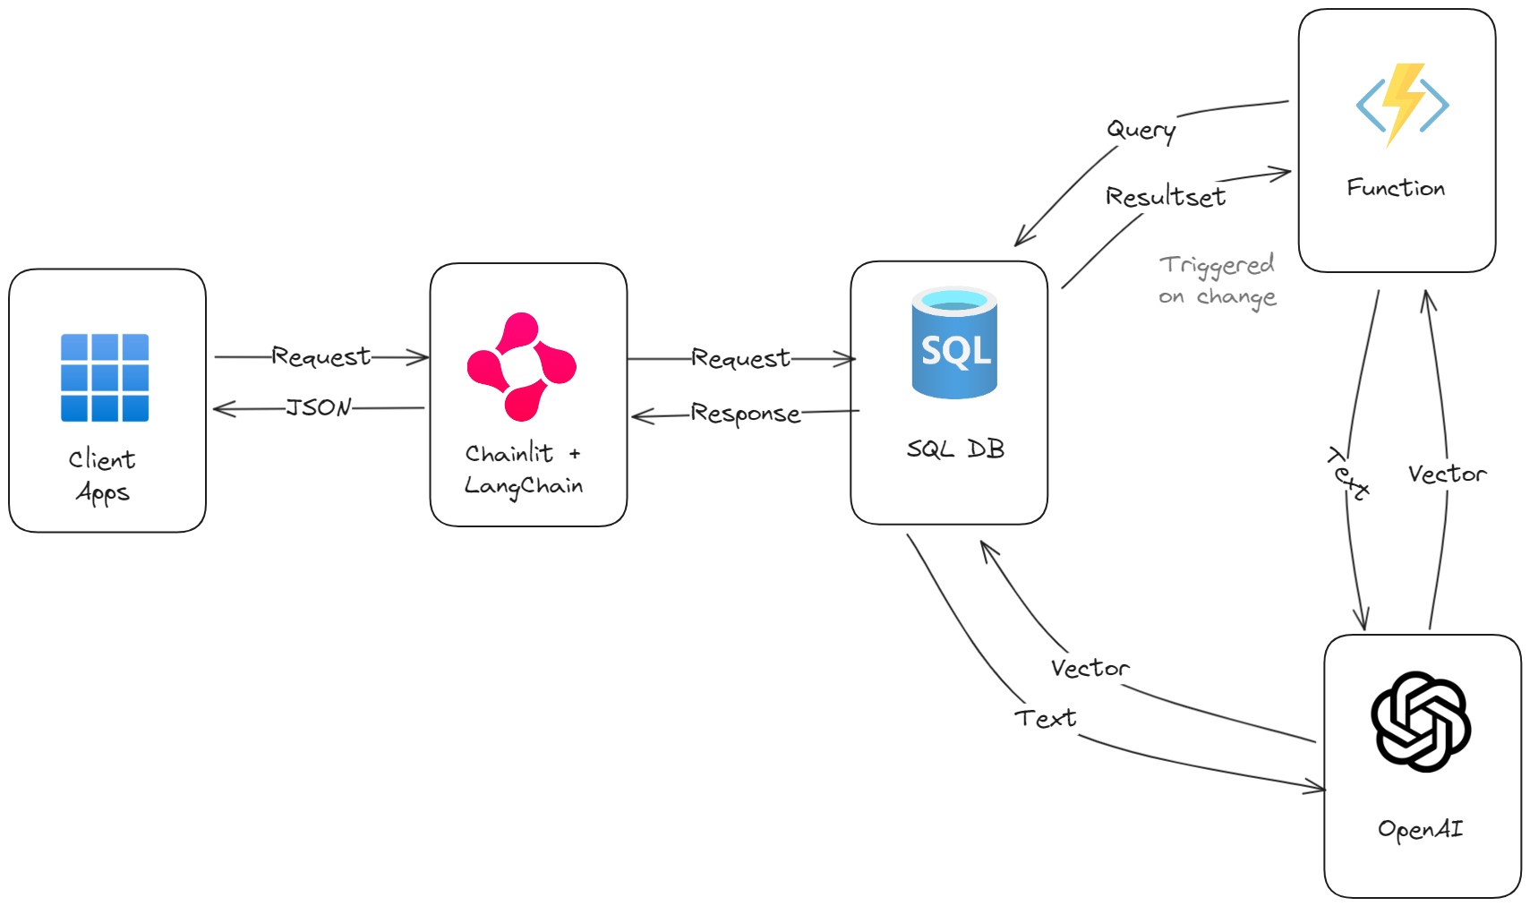
Azure SQL + LangChain + ChainLit Architecture

Slide 9
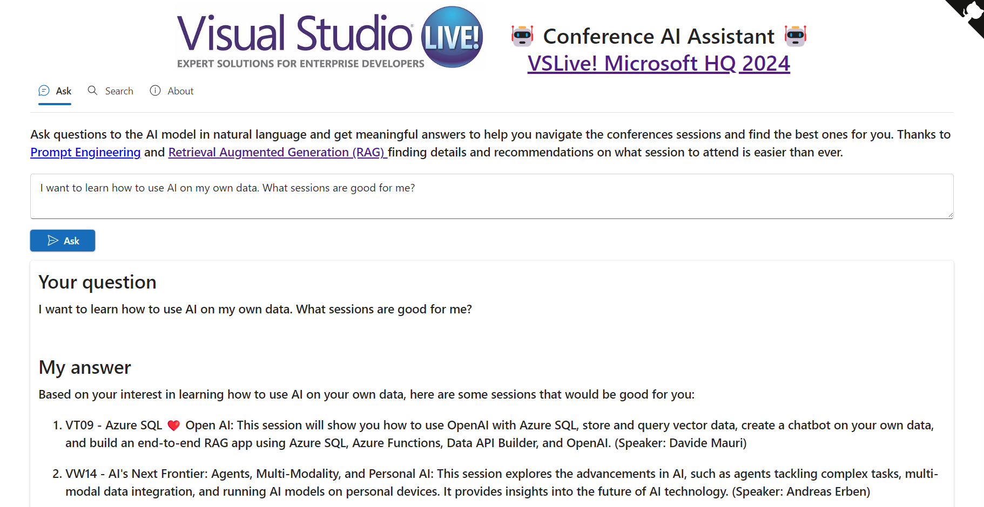
https://ai.microsofthq.vslive.com/

Slide 10

Thank you!

Slide 11
Text layout without bullet points
Main topic: Segoe UI, size 28pt
Segoe UI, size 20pt for second level
Segoe UI, size 16pt for third level

Slide 12
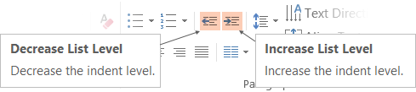
Text layout with bulleted text
Learn how to adjust list levels
Follow the steps on the right
Use the “Decrease List Level” and “Increase List Level” tools on the Home menu to change text levels.
Try this:
Place your cursor in the line of text that says “Segoe UI, size 20pt for second level”
Next click the Home tab, and then on the “Decrease List level” tool. Notice how the line moves up one level.
Now try placing your cursor in one of the top “Main topic…” line of text. Click the “Increase List Level” tool and see how the text is pushed in one level.
Use these 2 tools to adjust your text levels as you work

Slide 13
Two text columns with subheads
Add a subhead here
Add a second subhead here
This placeholder is designed with bulleted text
It’s easy to remove bullets
Select the text, then on the Home menu, click the bullet list icon
Keep the top edge of text blocks aligned
More text
More text

Slide 14
Three text columns with subheads
Space for a two-line subhead here
Wrap short
subheads
Adjust lower text blocks up or down
This placeholder is designed with bulleted text
It’s easy to remove bullets
Select the text, then on the Home menu, click the bullet list icon
Keep the top edge of text blocks aligned
More text
More text
Keep the top edge of text blocks aligned
More text
More text

Slide 15
Four text columns with subheads
Space for a two-line subhead here
Wrap short
subheads
Consistent line wraps look better
Adjust lower text up or down as needed
This placeholder is designed with bulleted text
It’s easy to remove bullets
Select the text, then on the Home menu, click the bullet list icon
Keep the top edge of text blocks aligned
More text
More text
Keep the top edge of text blocks aligned
More text
More text
Keep the top edge of text blocks aligned
More text
More text

Slide 16
Title square photo layout
Smaller text

Slide 17
Square photo layout

Slide 18
Two photos side-by-side layout
Click Home > Layout to find more photo layouts
Text placeholder

Slide 19
Three photos layout
Click Home > Layout to find more photo layouts
Text placeholder
Text placeholder

Slide 20
Four photos layout
Click Home > Layout to find more photo layouts
Text placeholder
Text placeholder
Text placeholder

Slide 21
Four round photos
Click Home > Layout to find more round photo layouts
Text placeholder
Text placeholder
Text placeholder

Slide 22
Two filmstrip photos
Click Home > Layout to find filmstrip layouts for three, four and five photos
Text placeholder

Slide 23
Five filmstrip photos
Click Home > Layout to find filmstrip layouts for two, three and four photos
Text placeholder
Text placeholder
Text placeholder
Text placeholder

Slide 24
Top photo with title

Slide 25
Full bleed photo lower title

Slide 26
Software code layout
main.js
async loadHeroes() {
this.message = 'getting the heroes, please be patient';
await this.getHeroesAction();
this.message = '';
},

Slide 27
Bottom code layout
Make your important points
Paste the code in the bottom section
Or paste from VS or VS Code using default light theme
main.js
async loadHeroes() {
this.message = 'getting the heroes, please be patient';
await this.getHeroesAction();
this.message = '';
},

Slide 28
Top code layout
main.js
async loadHeroes() {
this.message = 'getting the heroes, please be patient';
await this.getHeroesAction();
this.message = '';
},
Make your important points
Paste the code in the top section
Or paste from VS or VS Code using default light theme

Slide 29
Right code layout
main.js
async loadHeroes() {
this.message = 'getting the heroes, please be patient';
await this.getHeroesAction();
this.message = '';
},
Make your important points
Paste the code on the right side
Or paste from VS or VS Code using default light theme

Slide 30
Left code layout
main.js
async loadHeroes() {
this.message = 'getting the heroes, please be patient';
await this.getHeroesAction();
this.message = '';
},
Make your important points
Paste the code on the left side
Or paste from VS or VS Code using default light theme

Slide 31
Demo

Slide 33
Slide palette info
The PowerPoint palette for this template has been built for you and is shown below.
Avoid using too many colors in your presentation.
PowerPoint Theme Accent colors
Accent 1
Accent 2
Accent 3
Accent 4
Accent 5
Accent 6

Slide 34
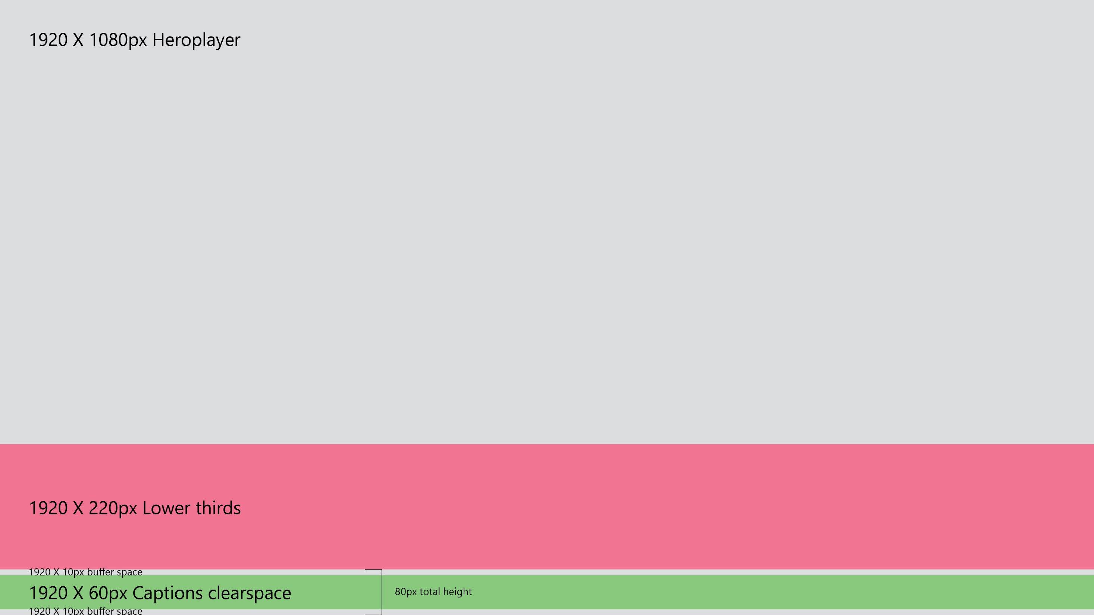
Close captions clear space
For digital events, please keep all presentation content above the dotted red line.
Area below the dotted red line will be used for closed captions.
Closed captions clear space. Keep all presentation content above the red line.

Slide 35

Ensure slide content is accessible
Take the following steps to create accessible content that everyone can consume effectively.
Contrast
Use high contrast colors for maximum readability
The recommended contrast ratio is at least 4.5:1
Shape and color
Use different shapes with a legend to indicate statuses to accommodate for color blindness
Example:
Alt text
Alt text helps people with screen readers understand the content of slides
You should create alternative text for shapes, pictures, charts, tables, SmartArt graphics, or other objects
Here’s how:
Right click on item
Select Edit Alt Text
Enter a Description
If an object is meant to add visual styling and doesn’t contain meaning (e.g., stylistic borders), do not add alt text and instead check Mark as decorative
Slide layouts
Using a built-in slide layout that matches your content ensures a hierarchical reading order of text blocks
Example:
If a new slide will have a title, rather than starting with a blank layout and adding a text block for the title, choose one of the built-in layouts with a title placeholder
Reading order
Screen readers describe content on the screen in the order it was created
To ensure your content is read back in the order you prefer, arrange your objects in the Selection Pane appropriately. Objects on the bottom of the selection pane are read first
Here’s how:
Click the Home tab
In the Drawing group, select the Arrange drop-down menu
Click Selection Pane…
Subject 1
Subject 2
Subject 3
Color Contrast Analyzer
Download this tool to determine the legibility of text and the contrast of visual elements
Download
C1
C2
C3
Additional tips
Be sure to run the Accessibility Checker! Go to File click the Check for Issues drop down menu click Check Accessibility
Videos need to be accessible: If your presentation includes a video, ensure it is captioned and audio described (if appropriate)
Visit the Office Accessibility Center to learn more about accessibility in PowerPoint

Slide 36
Guide for using AI tools
Use the following 5 guidelines when using AI tools to generate content for your presentations.
1
2
3
4
5
Review & revise
AI tools can be used as drafting/creation tools, but human editing must be part of the process and all final materials should be prepared with the same care and attention you use today. Any output from an AI tool (including text, images, video and audio) should be revised to a meaningful degree. Small amounts of text (1 sentence or less) do not need to be revised. AI output should also be reviewed and scrubbed of any third-party content, such as names, logos and brands.
Easy takedown
Only use AI tools to help create advertising, marketing and PR materials that are quick and easy to take down if necessary (e.g., social media, web content). AI tools should not be used to create materials such as packaging, physical retail assets or television commercials that cannot be quickly removed from circulation.
Avoid certain prompts
Avoid AI prompts including Microsoft Confidential Information (e.g., undisclosed information about pre-release products), unless the tool is approved for confidential data. Includes personal information belonging to any Microsoft employee, contractor, partner, vendor, customer or lead,
Avoid asking for content to be created in the style of a specific author or artist (e.g., avoid prompts such as, “Write a paragraph about the benefits of Edge with Bing in the style of Stephen King” or “Draw a Monet-style Xbox controller).
Disclosure
When using AI-generated images, audio or videos, include a disclosure explaining the role of AI in creating the content. For example, "Created with the help of AI" or "AI generated, human customized."
Review license terms
If you want to use a tool other than Bing chatbot, Bing Image Creator, or another Microsoft AI feature, contact your CELA representative to review the applicable license terms to ensure the tool can be used for your intended purpose and to understand any licensing restrictions or requirements
Source: Using AI to Create Advertising, Marketing and PR Content (Internal access only)
Contact: If you have any questions, comments or concerns contact your team CELA representative. All suppliers should direct questions to execppt@microsoft.com.

Slide 37
Microsoft brand colors
Type and background combinations must meet a minimum 4.5:1 contrast ratio to help ensure people of all abilities can access and understand our communications. Pick colors carefully and avoid relying on color alone to convey information.
 | Whites | Warm grays | Cold grays | Browns | Yellows | Oranges | Reds | Magenta | Blues | Purples | Teals | Greens | Blacks
Light
Mid
Darks
Pure White
R255 G255 B255
Hex #FFFFFF
Warm Light Gray
R232 G230 B223
Hex #E8E6DF
Light Gray
R217 G217 B214
Hex #D9D9D6
Light Brown
R225 G211 B199
Hex #E1D3C7
Light Yellow
R255 G227 B153
Hex #FFE399
Light Orange
R255 G163 B139
Hex #FFA38B
Light Red
R255 G179 B187
Hex #FFB3BB
Light Magenta
R213 G158 B215
Hex #D59ED7
Light Purple
R197 G180 B227
Hex #C5B4E3
Light Blue
R141 G200 B232
Hex #8DC8E8
Light Teal
R185 G220 B210
Hex #B9DCD2
Light Green
R212 G236 B142
Hex #D4EC8E
Blue Black
R9 G31 B44
Hex #091F2C
Off White
R244 G243 B245
Hex # F4F3F5
Mid Gray
R215 G210 B203
Hex #D7D2CB
Cool Gray
R177 G179 B179
Hex #B1B3B3
Brown
R191 G148 B116
Hex #BF9474
Yellow
R255 G185 B0
Hex #FFB900
Orange
R255 G92 B57
Hex #FF5C39
Red
R244 G54 B76
Hex #F4364C
Magenta
R192 G59 B196
Hex #C03BC4
Purple
R134 G97 B197
Hex #8661C5
Blue
R0 G120 B212
Hex #0078D4
Teal
R73 G197 B177
Hex #49C5B1
Green
R141 G233 B113
Hex #8DE971
Pure Black
R0 G0 B0
Hex #000000
Warm White
R255 G248 B243
Hex #FFF8F3
Warm Gray
R140 G130 B121
Hex #8C8279
Dark Gray
R69 G65 B66
Hex #454142
Dark Brown
R92 G71 B56
Hex #5C4738
Dark Yellow
R127 G90 B26
Hex #7F5A1A
Dark Orange
R115 G57 B29
Hex #73391D
Dark Red
R115 G38 B47
Hex #73262F
Dark Magenta
R112 G37 B115
Hex #702573
Dark Purple
R70 G54 B104
Hex #463668
Dark Blue
R42 G68 B111
Hex #2A446F
Dark Teal
R34 G91 B98
Hex #225B62
Dark Green
R7 G100 B29
Hex #07641D
Brown Black
R41 G24 B23
Hex #291817
Get the Color Contrast Analyzer
Get more information on accessibility
Get the Microsoft color guidelines PDF

Slide 38





PowerPoint Design Ideas
PowerPoint Designer can create suggestions for your slide content.
To access Design Ideas, click the “Design” tab in the Ribbon and then “Design Ideas” on the right.
Designer will also trigger when you insert an image.

